Slide 1
Project Proposal: Application of Computer Vision in Ecology
Fedor Chursin
220904

Slide 2
Table of contents
Value Proposition & Business Understanding
Responsible AI
Proof-of-Concept
Explainable AI
Disruptive technology risks
Human Centered AI

Slide 3
Value Proposition & Business Understanding

Slide 4
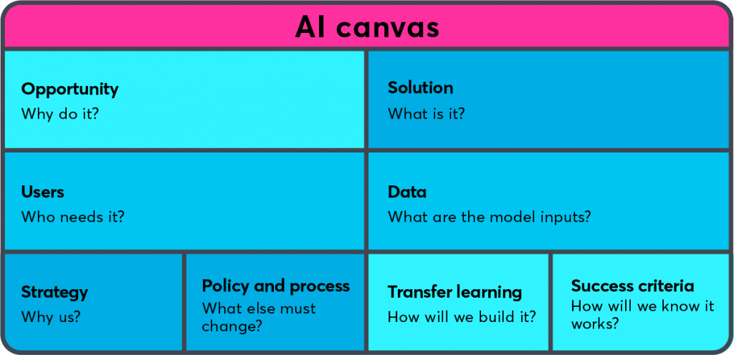
AI Canvas: provide high-level overview
In the market of apps related to ecology, there is a need for a carbon footprint tracker that also gives tips on how to reduce it and is easy to use.
Mobile app with embedded computer vision application that will help people to track their personal CO2 footprint and will give tips on how to reduce it.
People who are concerned about ecology and want to contribute to the improvement of the ecological state of our planet
An image of the meal taken by an app user
Ecological market should be adjusted to increase it capacities
CNN model + transfer learning with VGG16 model and data augmentation
A model with high performance + High-quality app

Slide 5
Market research & Target audience analysis
Lack of high-quality tools for tracking and reducing the carbon footprint
Recently there is a growth in interest towards ecology
People want to contribute towards improving ecological state of the planet
'Eco-friendly trends'
A new approach using computer vision to improve users' experience
A gap in the market for an advanced carbon footprint mobile application

Slide 6
Target audience analysis
12 – 65
Years Old
No geographic segmentation
Eco-Friendly Lifestyle
Environmentally conscious people
45-50% of consumers worldwide

Slide 7
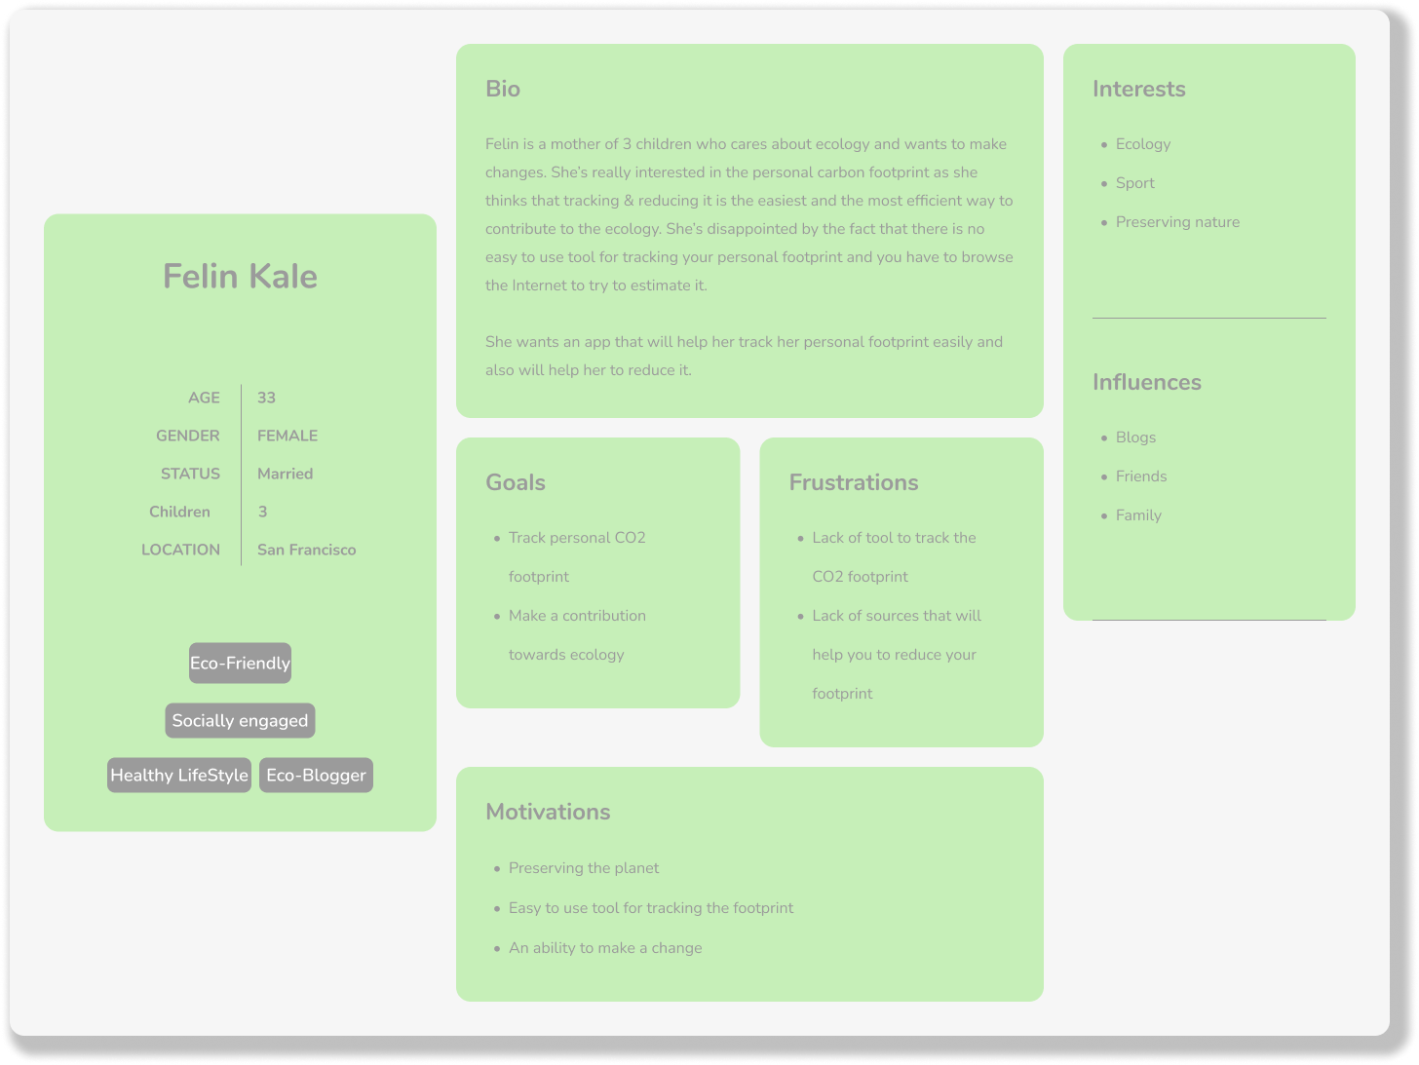
Target audience analysis

Slide 8
Proposal feasibility
Accurate & Easy to Use CV Model
Ecological Trends
UI Design & High-Quality App
Market Research & Marketing

Slide 9
Responsible AI

Slide 10
Responsible AI
Imsitu Dataset
Feminist Theory Bias
Privilege Bias
Misrepresentation Bias

Slide 11
Responsible AI
Fairness Through Awareness
Biased Dataset
Gather More Data to Mitigate Biases
Biased Model
Unbiased Model
Poor performance
Inaccurate & Biased Predictions
Better performance
Accurate & Unbiased Predictions

Slide 12
Proof-of-Concept: Deep Learning

Slide 13
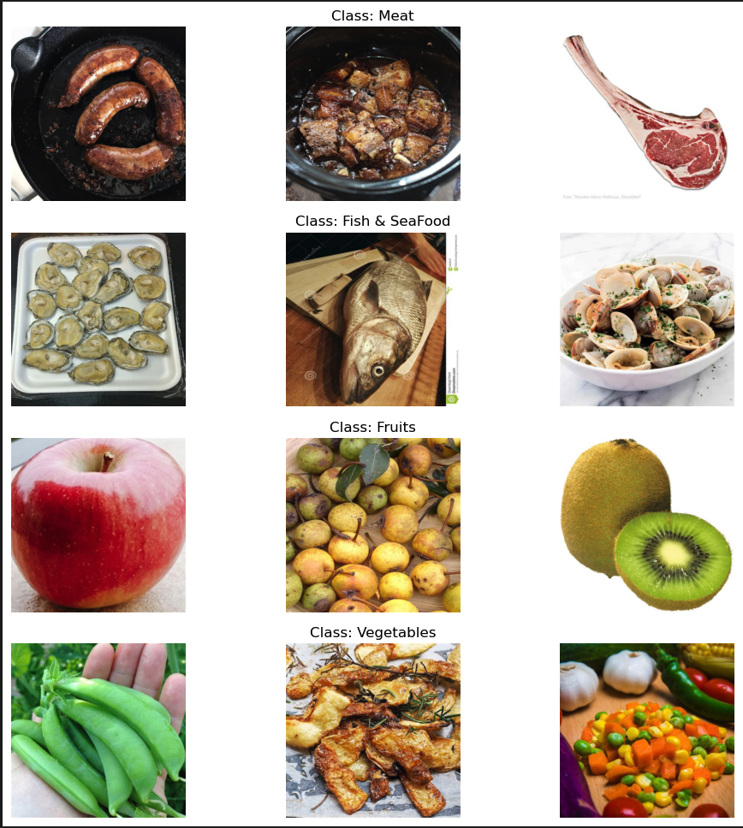
PoC: The dataset
Multi-class classification
4 classes:
Meat
Fish & Seafood
Fruits
Vegetables
184 images in each class
Quality > Quantity

Slide 14
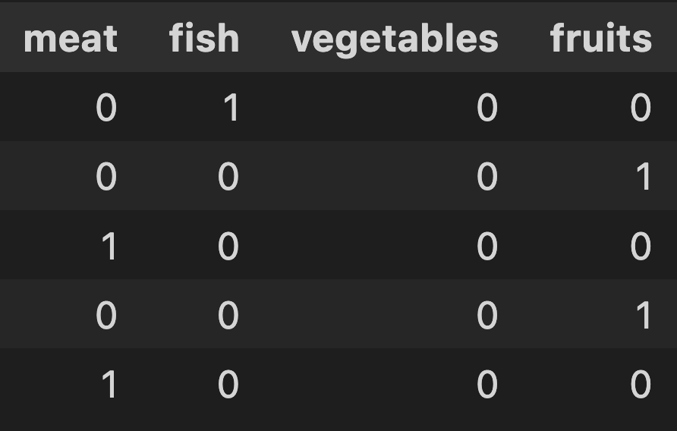
PoC: The dataset
80% 10% 10% - Train Test Validation split
Images are resized to 128 x 128
Images are labelled accordingly to the file paths
95%
5%
DuckDuckGo API
Imsitu Dataset

Slide 15
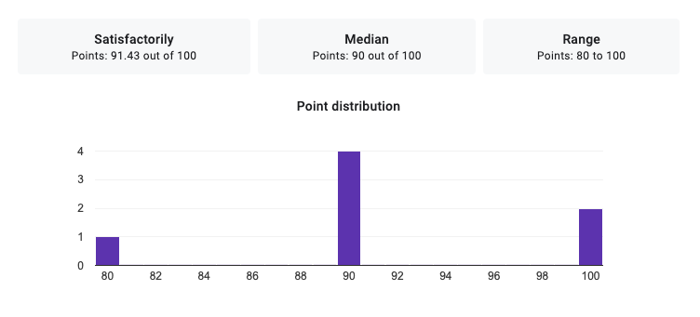
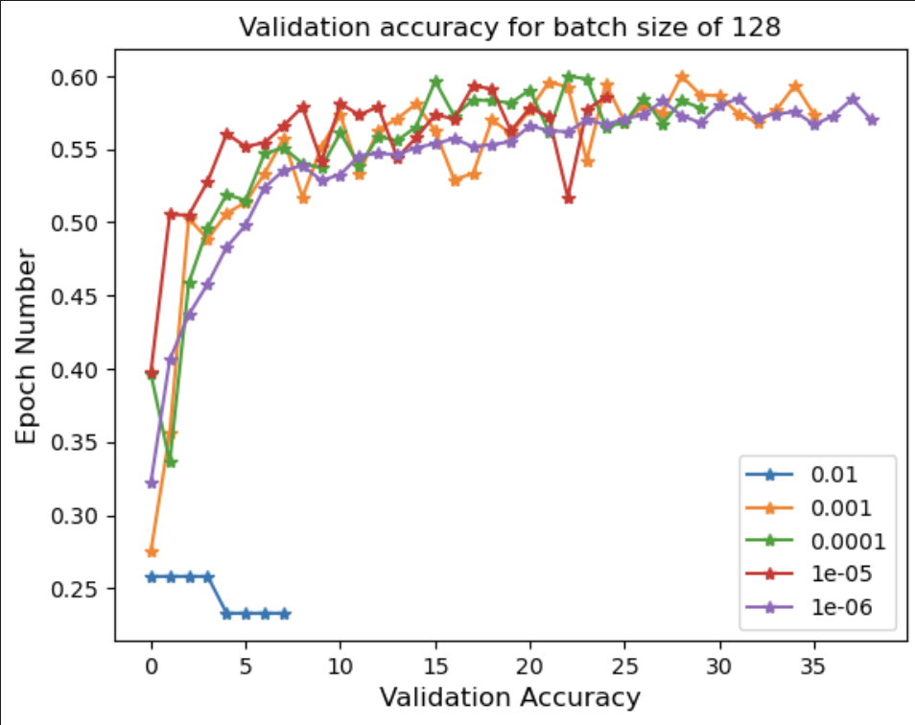
PoC: Baselines
Random Guess – 25%
HLP – 90%
Multilayer Perceptron Accuracy – 57% - 62%

Slide 16
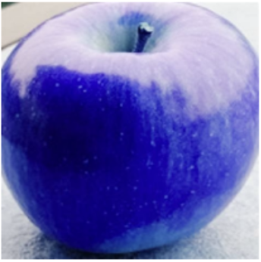
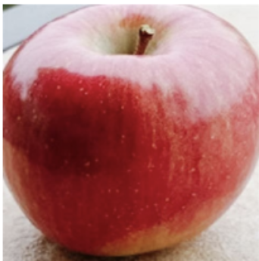
PoC: Preprocessing
Change colour scheme
Resize the image by 128 x 128
Apply data augmentation 1 => 10
Load image into numpy array

Slide 17
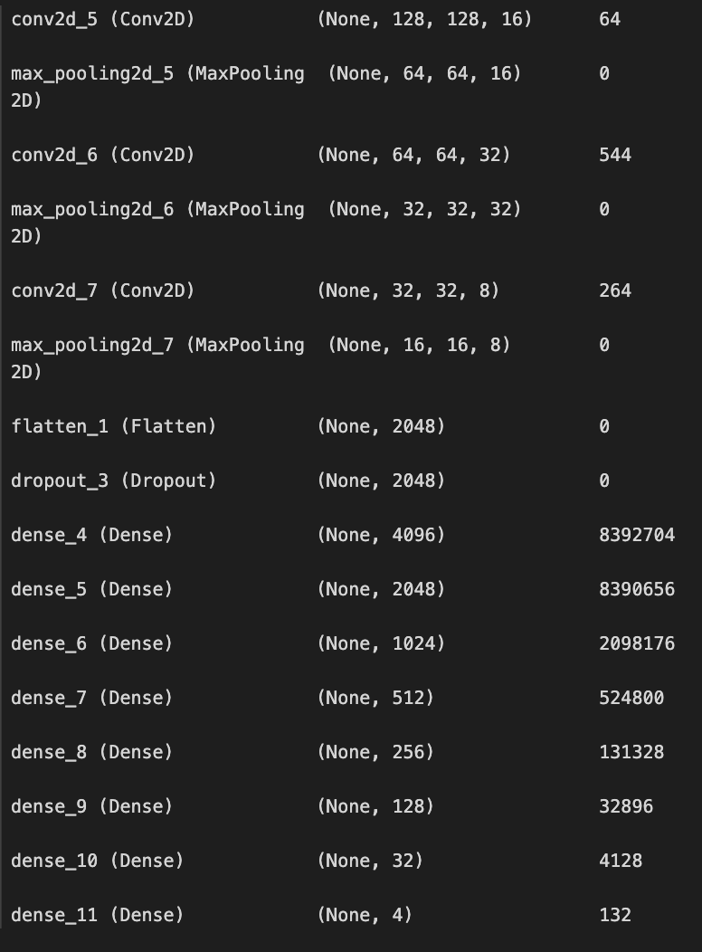
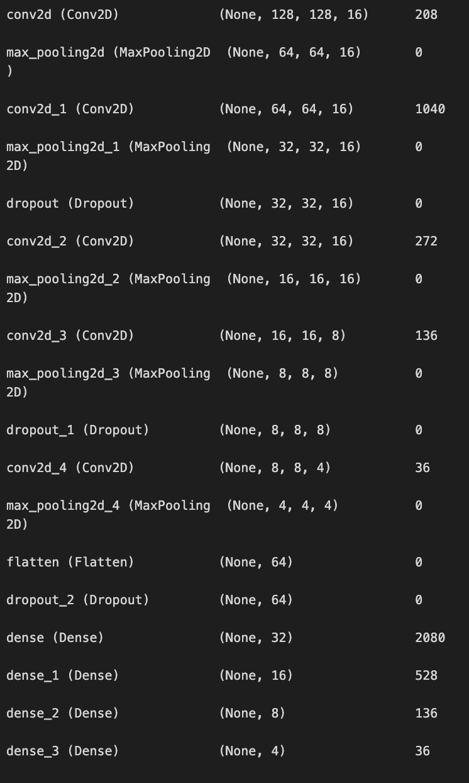
PoC: CNN architecture
Tuned base-line model
Base-line model

Slide 18
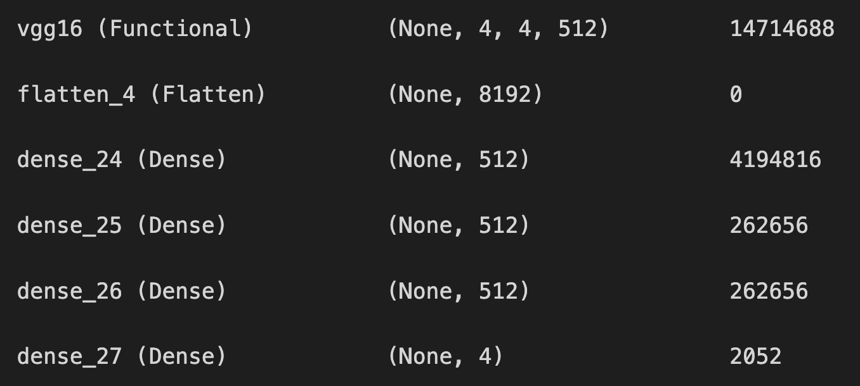
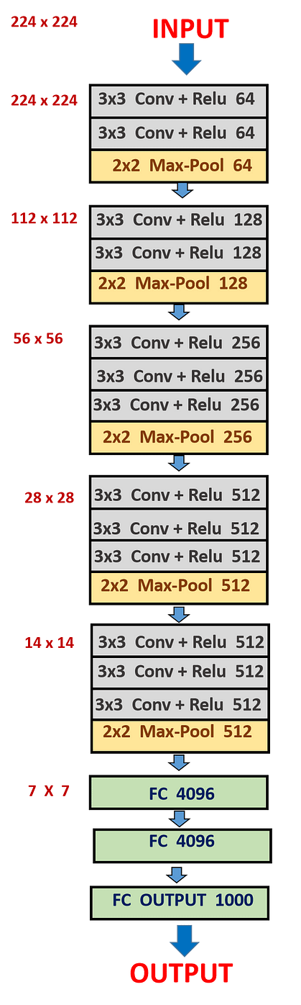
PoC: CNN architecture
Transfer learning model
VGG16
4 Dense Layers

Slide 19
PoC: CNN training
 | Loss function | Optimizer | Learning rate | Metrics
Base-line model | Categorical cross-entropy | Adam | 0.001 | Loss & Accuracy
Improved base-line model | Categorical cross-entropy | Rmsprop | 0.001 | Loss & Accuracy
Transfer-learning model | Categorical cross-entropy | Adam | 0.001 | Loss & Accuracy

Slide 20
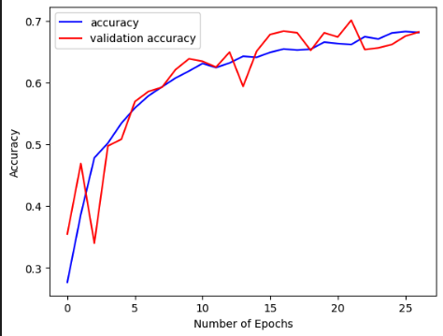
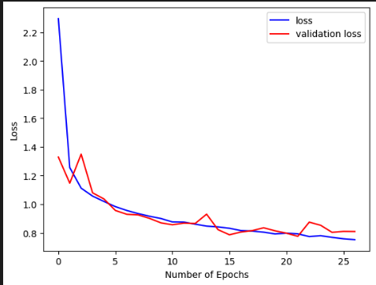
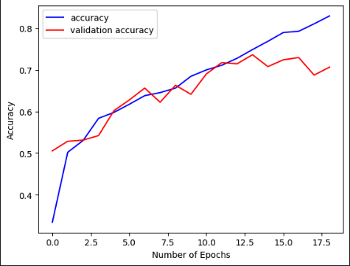
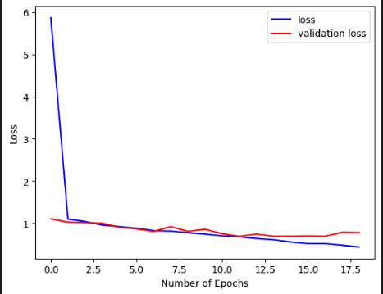
PoC: CNN training
Baseline model
150 Epochs
EarlyStopping monitoring val_accuracy with patience of 5
Restore_best_weights = true
Prevents overfitting
Improved baseline model

Slide 21
PoC: Model performance
 | Precision | Recall | F1-score | Accuracy on unseen data
Base-line model | 0.67 | 0.64 | 0.64 | 0.65
Improved base-line model | 0.70 | 0.71 | 0.7 | 0.72
Transfer-learning model | 0.79 | 0.79 | 0.8 | 0.82

Slide 22
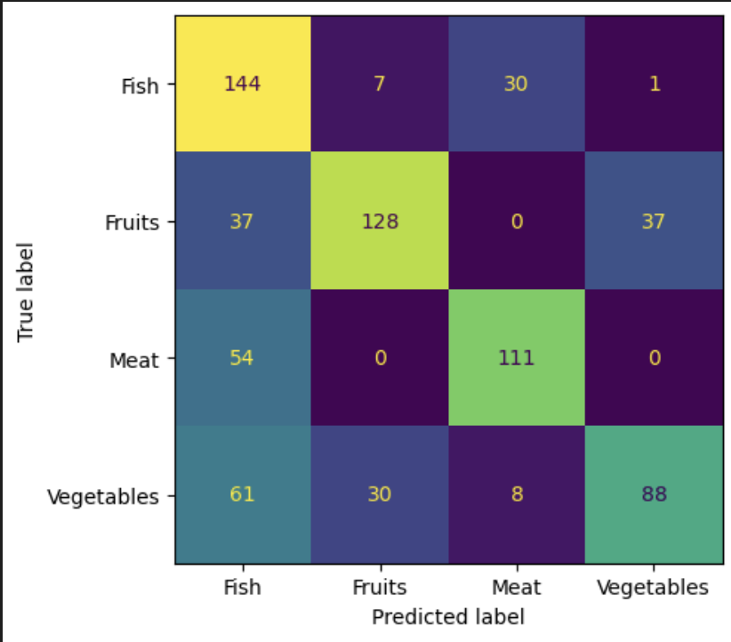
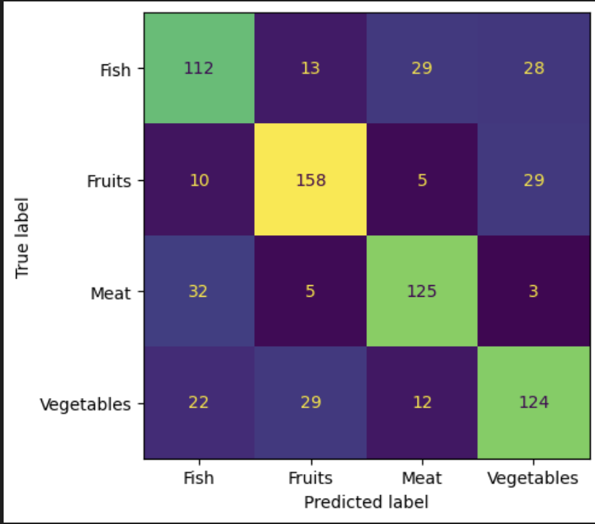
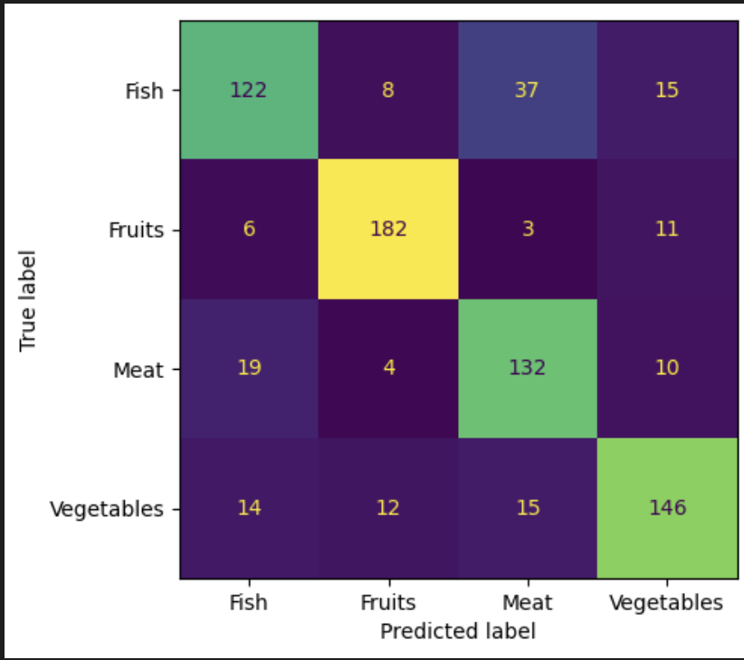
PoC: Model performance
Base-line model
Tuned base-line model
Transfer-learning model

Slide 23
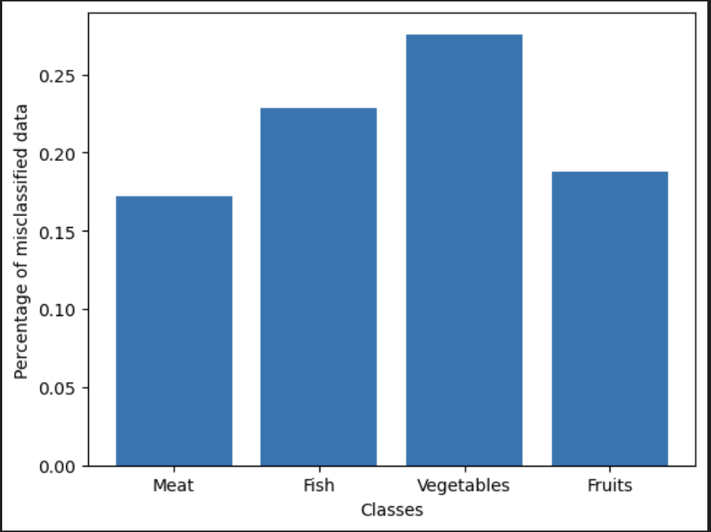
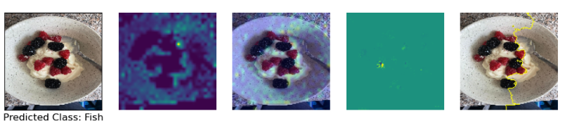
PoC: Error analysis
Most misclassified classes:
Vegetables – 26% of the data
Fish – 23% of the data
3 main reasons

Slide 24
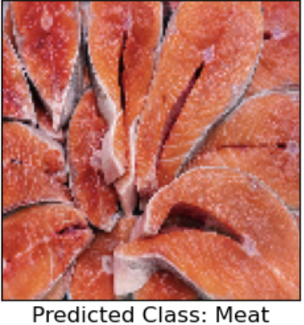
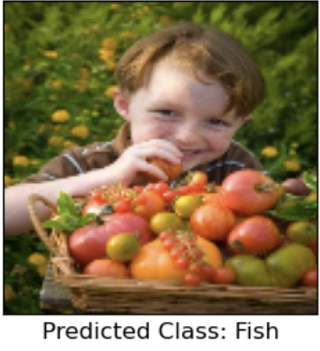
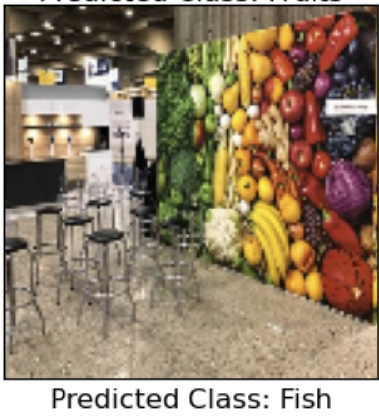
PoC: Error analysis
Lack of data
Noise in data
Low-quality ('Garbage') data

Slide 25
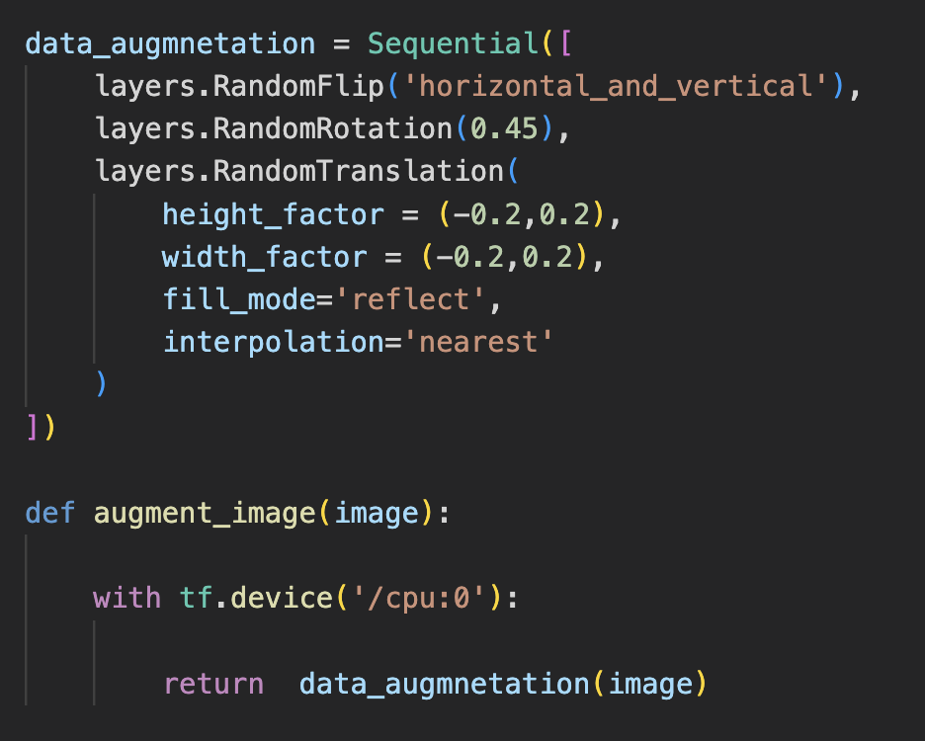
PoC: Iteration
Data Augmentation
Transfer Learning
Improve Data
Model tunning

Slide 26
Responsible AI (Transparency & Interpretability)

Slide 27
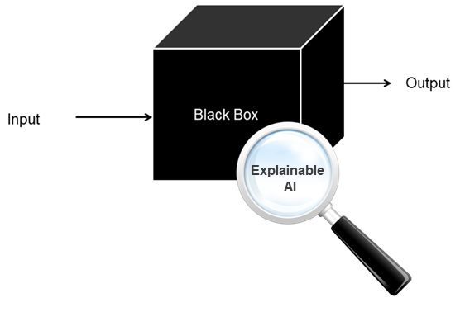
Responsible AI (Transparency & Interpretability)
Deep Learning models are hard to interpret
Sometimes you have to sacrifice accuracy to explain the model
Several methods are needed to understand what is under the hood
Accuracy > Explainability

Slide 28
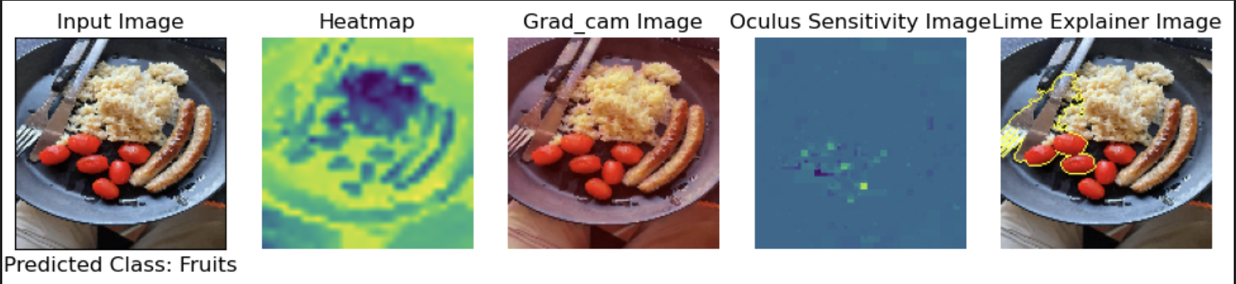
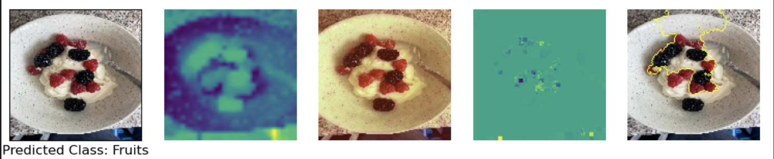
Responsible AI
Accuracy – 75%
Outputs are explained with 3 different methods:
Grad_cams
Oculus sensitivity
Lime explainer
Tuned base-line model explained by XAI methods

Slide 29
Disruptive Technology Risks

Slide 30
Disruptive Technology Risks
Risks
Contingency Plan
Inaccurate model => Inaccurate carbon footprint
Inaccurate carbon footprint measurement data for different actions => Useless tips on how to reduce personal footprint
The growth in the interest in ecology and in the number of people who want to make a difference => Market is not ready
Constant improvement of the model used for food labeling
Conduct research on a carbon footprint emissions caused by a broad range of different actions
Integrate & promote eco-friendly habits step by step to promote investments in this area of the market and increase it capacities

Slide 31
HCAI - Application Design:

Slide 32
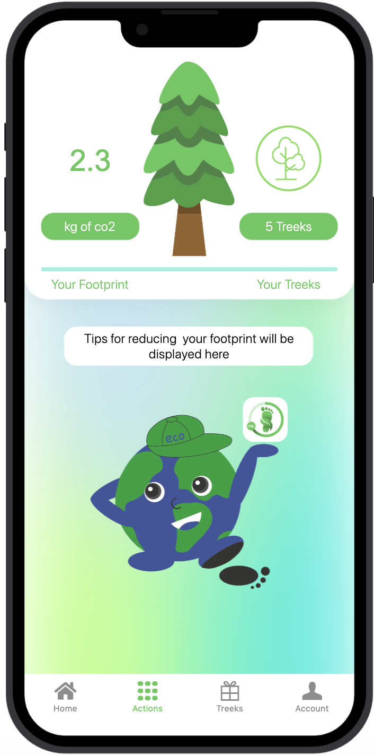
HCAI - Application Design:
High-level concept design:
Users - Environmentally conscious people
Problem – lack of tools to track personal carbon footprint
Mobile app – is a personal carbon footprint tracker, that also helps to reduce your footprint
Daily interaction
Colour scheme – eco-related colours

Slide 33
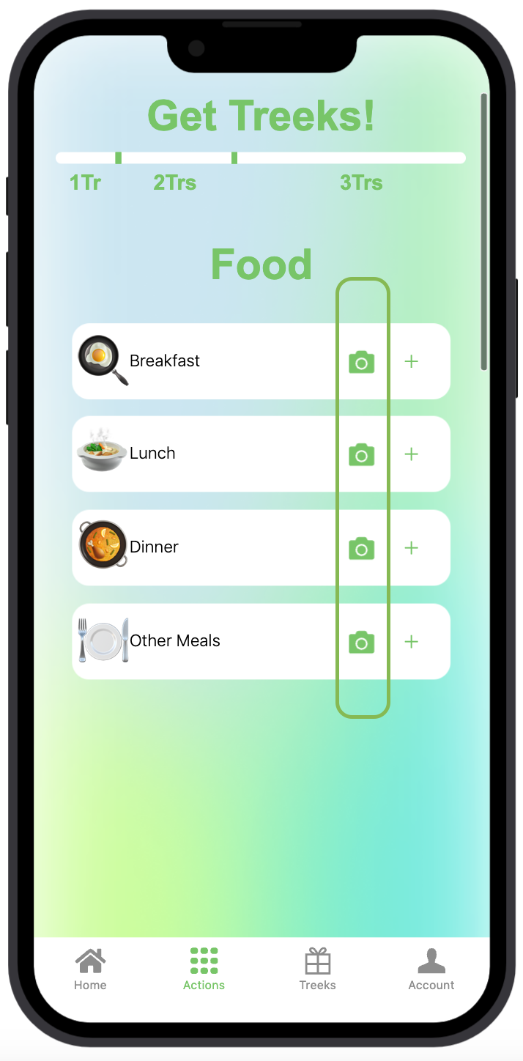
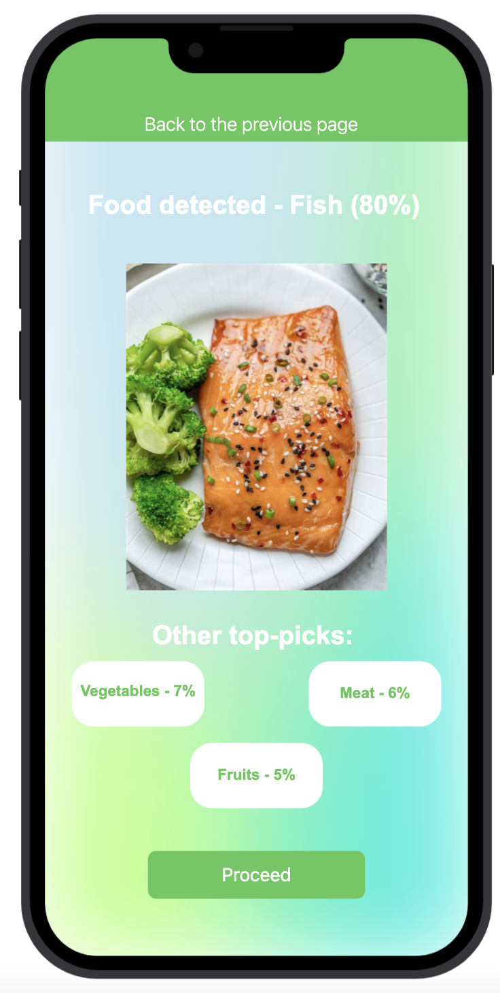
HCAI - Application Design
Algorithm Embedding:
The algorithm is embedded in one of the app screens, that can be accessed from the actions screen
The algorithm will label food on the meal picture taken by a user
Object detection and weight assumption

Slide 34
HCAI - Application Design:
Continuous Learning
Users can correct the model's predictions by simply clicking on one of 3 buttons to change the food label
Buttons are sorted in descending order from highest probability to lowest
If the label is changed => Algorithm will adjust its predictions based on the feedback from the user

Slide 35
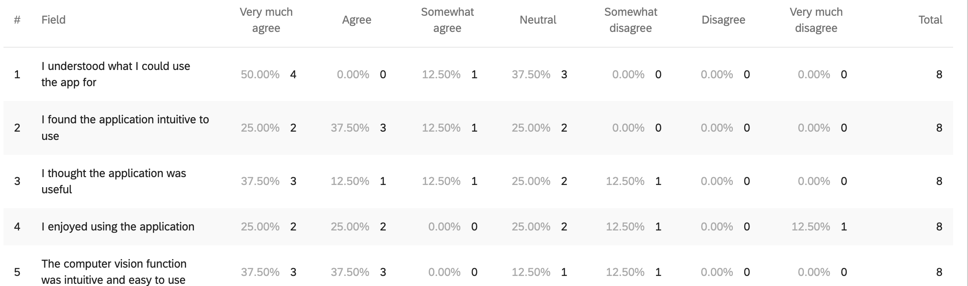
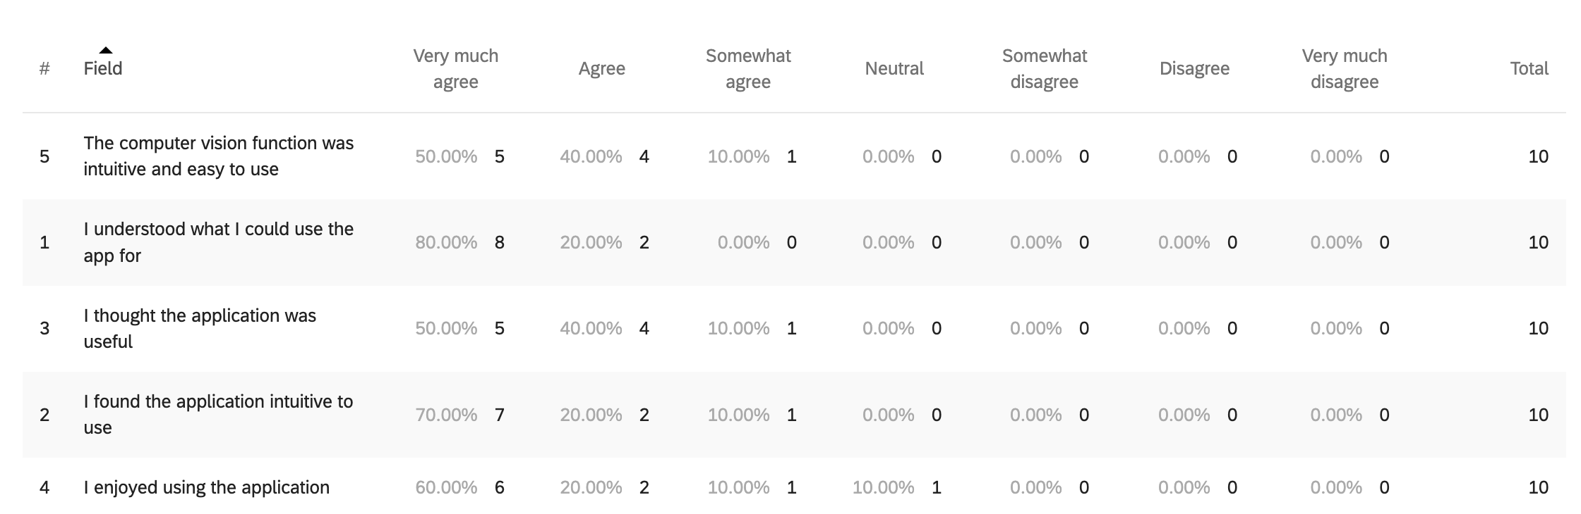
HCAI - Application Design:
Several user testing methodologies:
A/B Testing
Paper prototyping
Users feedback
Samples T-test

Slide 36
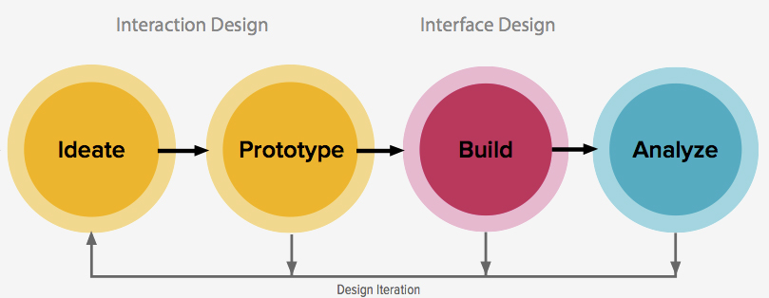
HCAI - Application Design:
Several UI design iterations
Improved aspects:
UI design
User Experience
Algorithm implementation
Recommendations and continuous learning

Slide 37
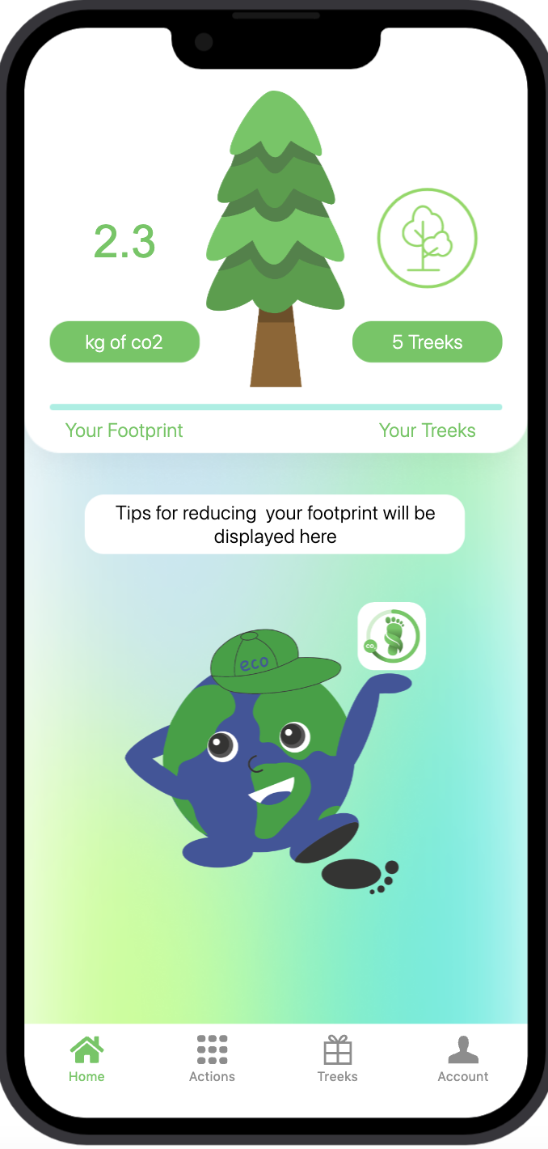
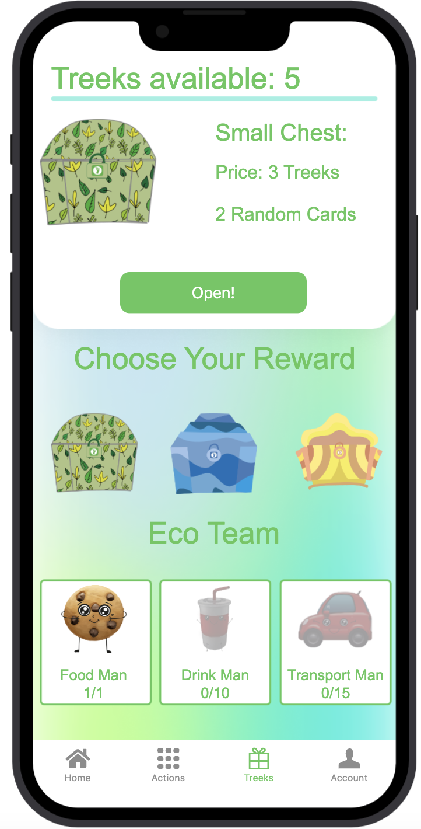
HCAI - Application Design:
Low-level design:
The application provides personal recommendations on how to reduce personal carbon footprint
Users will get notifications twice a day with a reminder to track their footprint
Rewards system is integrated in the app to increase engagement rate
To show the impact on the planet there is a tree indicator that slowly dies as the CO2 footprint increases

Slide 38
HCAI - Application Design:
App Prototype Zip
App Prototype Html File
App Prototype Folder Unzipped
Prototype Showcase
Proto.io prototype

Slide 39
Thank you!
Any questions?

